Slide 1
Name : N.Vignesh Reg.No : 730321104061 NM Id : au730321104061 Degree : B.E - CSE Year : III College name : Builders Engineering College
3/21/2024 Annual Review

Slide 2
PROJECT TITLE
Text to Speech Generation using RNN- Recurrent Neural Network
3/21/2024 Annual Review

Slide 3


AGENDA
Data Preprocessing
Model Selection
Training the model
Feature Extraction
Synthesis
Customizing the extracts
Output generation
Result
3/21/2024 Annual Review

Slide 4

PROBLEM STATEMENT
To develop a text-to-voice generation system aims to convert written text into natural-sounding speech, facilitating accessibility and enhancing user experience across various applications.
3/21/2024 Annual Review

Slide 5

PROJECT OVERVIEW
RNNs are neural networks designed to process sequential data by maintaining an internal state to capture temporal dependencies.
People who are deaf and dumb are struggling to communicate with society
For those to overcome their difficulties, I developed this Text to Speech generation project using RNN
3/21/2024 Annual Review

Slide 6

WHO ARE THE END USERS?
Language learners
Individuals with impairments
Consumers of audiobooks
Navigation system users
Story readers
Library usagers
3/21/2024 Annual Review

Slide 7

YOUR SOLUTION AND ITS VALUE PROPOSITION
My solution is to utilize deep learning models such as RNN – Recurrent Neural Network to develop a text to voice generation tool for those in need.
VALUE PROPOSITIONS
Accuracy
Pronounciation
Rate of generation
Spelling precision
3/21/2024 Annual Review

Slide 8

THE WOW IN YOUR SOLUTION
High Accuracy and Precision
Realtime responsiveness
Seamless integration and Customization
Highly interative
3/21/2024 Annual Review
8

Slide 9
MODELLING
Computational representation
Data collection
Data preprocessing
Data classification
Measuring the propositions
Synthesisation
Audio generation
3/21/2024 Annual Review
9

Slide 10
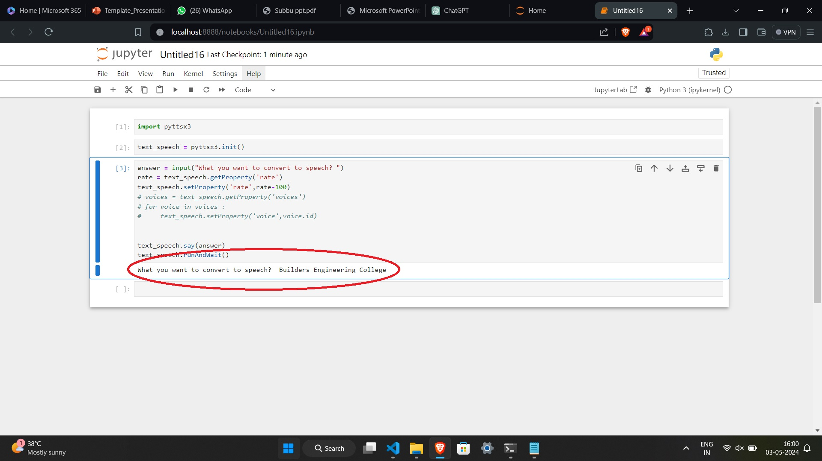
RESULTS
3/21/2024 Annual Review
10

